Slide 1


DATA VISUALIZATION & GRAPHICS
PRESENTED BY:
SINTHIYA THAVAM
(MSC NEUROSCIENCE)

Slide 2
SCATTER PLOT

Slide 3
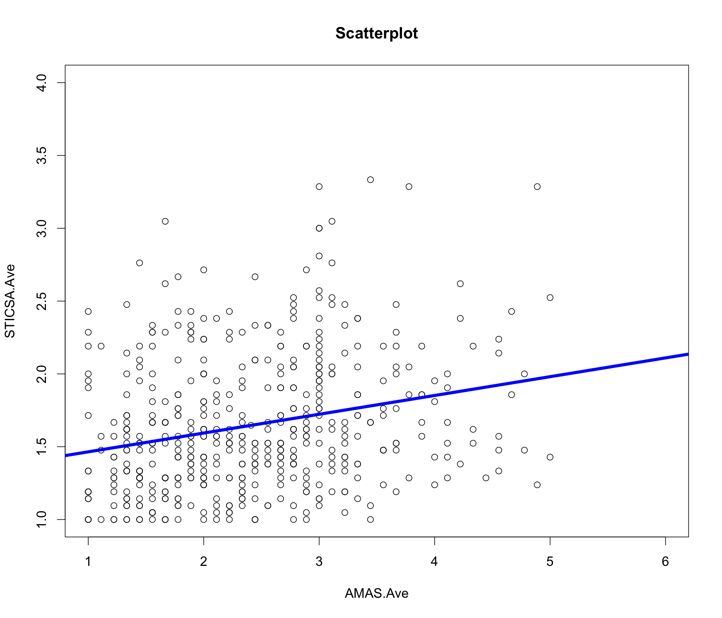

Slide 4
SCATTER PLOT
plot(AMAS.Ave, STICSA.Ave, main="Scatterplot", xlim =c(1, 6), ylim = c(1, 4))
‘xlim’ (x-axis limit)
‘ylim’ (y-axis limit)
abline(lm(STICSA.Ave~AMAS.Ave), col=4, lwd=5)
‘lm’ (regression line)
‘col’ (colour)
‘lwd’ (thickness of the regression line)
Name regression line (ex: mod)
Statistics (bi-variate correlation, ex: r = ~ 0.25 )
mod<- lm(STICSA.Ave~AMAS.Ave)
summary(mod)
Notes:
Assignment 1 script

Slide 5
BOX PLOT

Slide 6
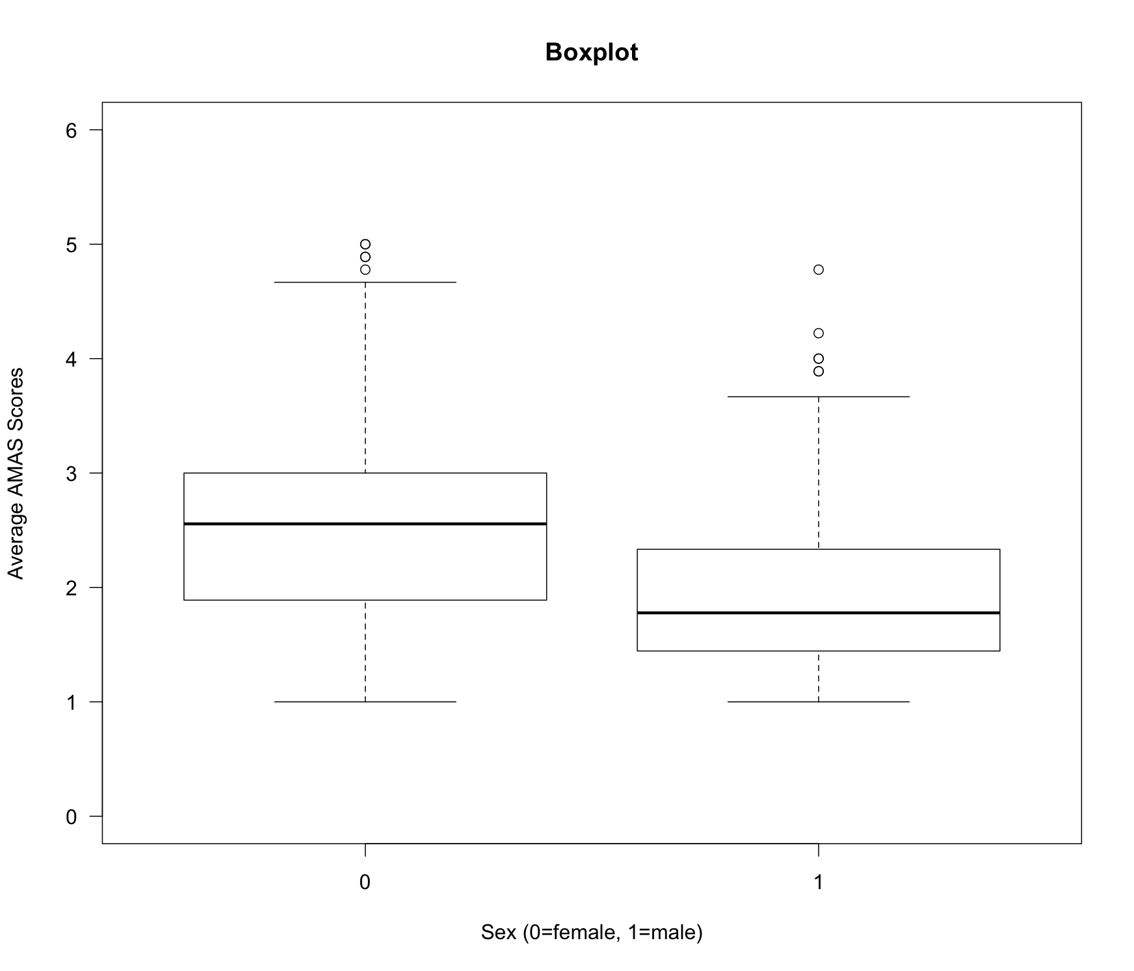

Slide 7
BOX PLOT
boxplot(AMAS.Ave~AMAS.Sex, main="Boxplot", ylab= "Average AMAS Scores", xlab= "Sex (0=female, 1=male)", ylim=c(0, 6), las=1)
‘las’ (orientation of the axis #: side ways or right side up)
1, 2, 3
Notes:
R Markdown Assignment 2

Slide 8
LINE GRAPH

Slide 9
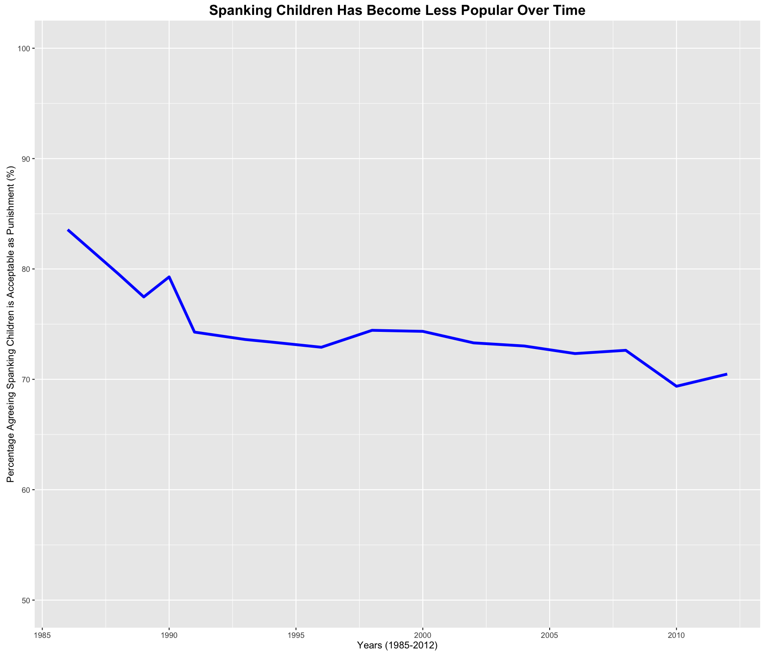

Slide 10
LINE GRAPH (ONE LINE)
library(ggplot2)
Package
x<-ggplot(data=meanAgree, aes(x=YEAR, y=Agree*100))
x+geom_line(colour='blue', size=1.5) + ylim(50, 100)+ggtitle('Spanking Children Has Become Less Popular Over Time')+ylab('Percentage Agreeing Spanking Children is Acceptable as Punishment (%)')+xlab('Years (1985-2012)')+theme(plot.title=element_text(face='bold', size = 16))
Add information to ‘x’
Plot title (font size ex. 16)
Notes:
R Markdown Assignment 3 Final
Agree*100 (percentage)

Slide 11
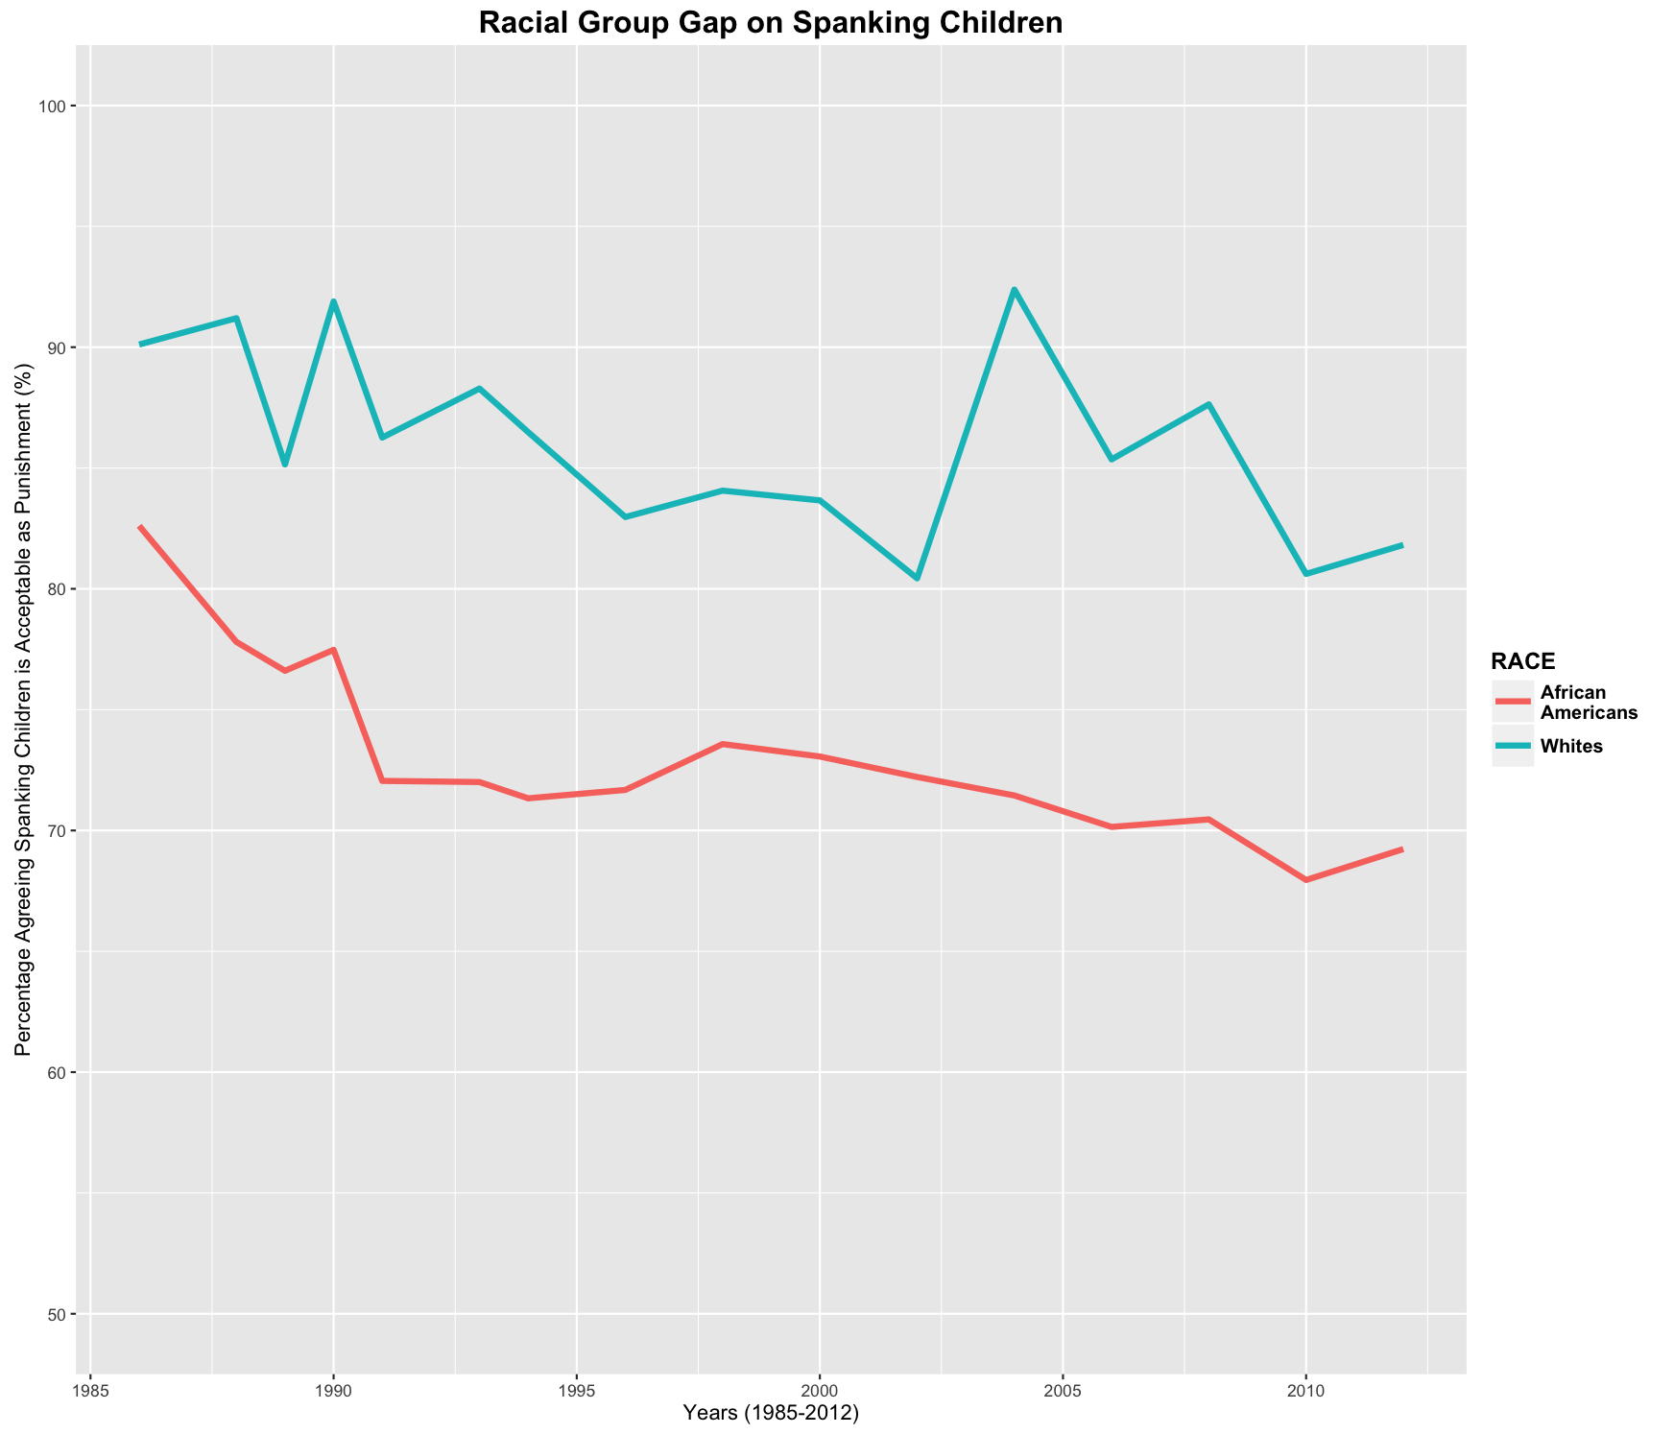

Slide 12
LINE GRAPH (TWO LINES)
x2<-ggplot(data = meanRace, aes(x=YEAR, y=Agree*100, colour = RACE, group =RACE))
x2+ylim (50, 100)+ggtitle('Racial Group Gap on Spanking Children') + geom_line(size=1.5)+scale_color_hue(name='RACE', breaks=c('1','2'), labels=c('African\nAmericans', 'Whites'))+ylab('Percentage Agreeing Spanking Children is Acceptable as Punishment (%)')+xlab('Years (1985-2012)')+theme(legend.title=element_text(face='bold', size = 12))+theme(plot.title=element_text(face='bold', size = 16))+theme(legend.text=element_text(face='bold', size=10))
Add information to ‘x2’
‘/n’ (breaks the title)
‘geom_line’ (each group’s line)
‘breaks’ (each # associates with each race group ex: 1 = African Americans)

Slide 13
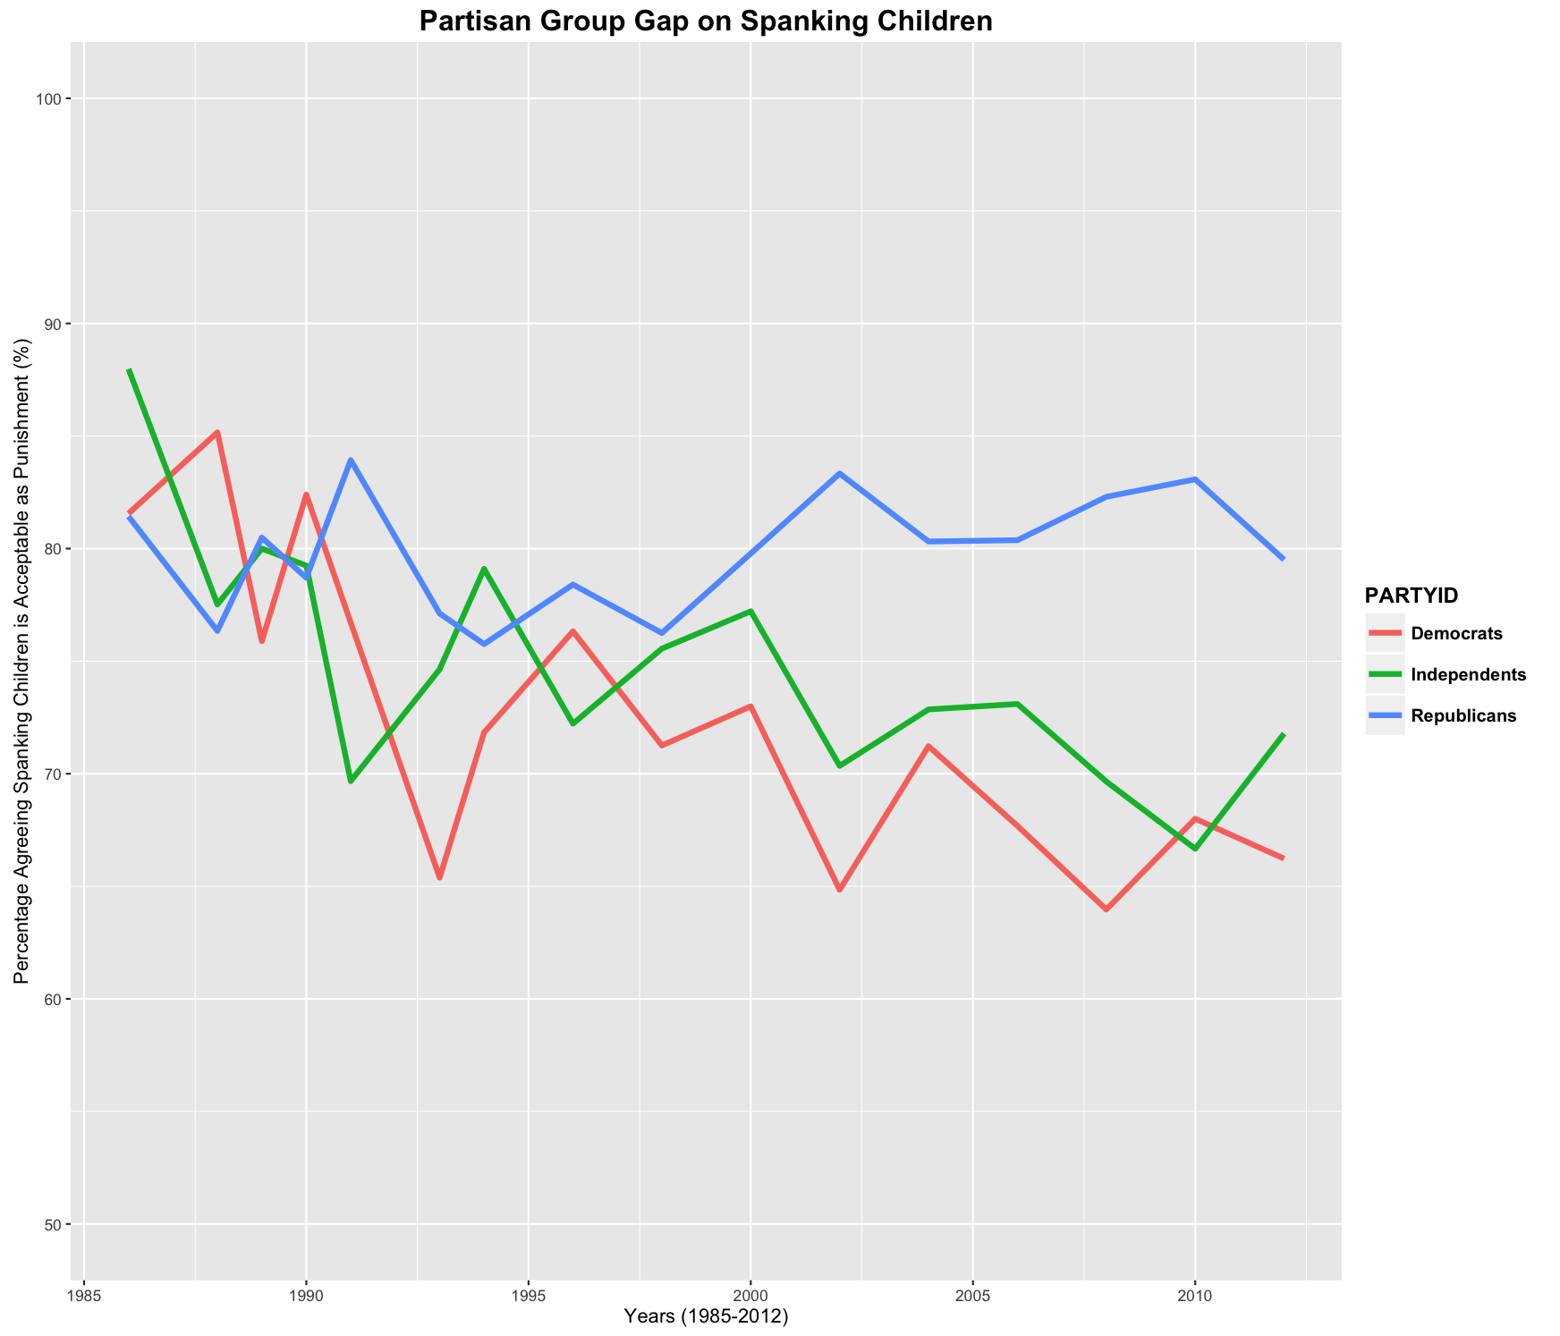

Slide 14
LINE GRAPH (THREE LINES)
x3<-ggplot(data = meanParty, aes(x=YEAR, y=Agree*100, colour = PARTYID, group =PARTYID))
x3+ylim (50,100)+ggtitle('Partisan Group Gap on Spanking Children') +geom_line(size=1.5)+scale_color_hue(name='PARTYID', breaks=c('0','3','6'), labels=c('Democrats','Independents','Republicans'))+ylab('Percentage Agreeing Spanking Children is Acceptable as Punishment (%)')+xlab('Years (1985-2012)')+theme(legend.title=element_text(face='bold', size = 12))+theme(plot.title=element_text(face='bold', size = 16))+theme(legend.text=element_text(face='bold', size=10))
Add information to ‘x3’
‘/n’ (breaks the title)
‘geom_line’ (each group’s line)
‘breaks’ (each # associates with each party group ex: 0 = Democrats)

Slide 15
BAR GRAPH

Slide 16
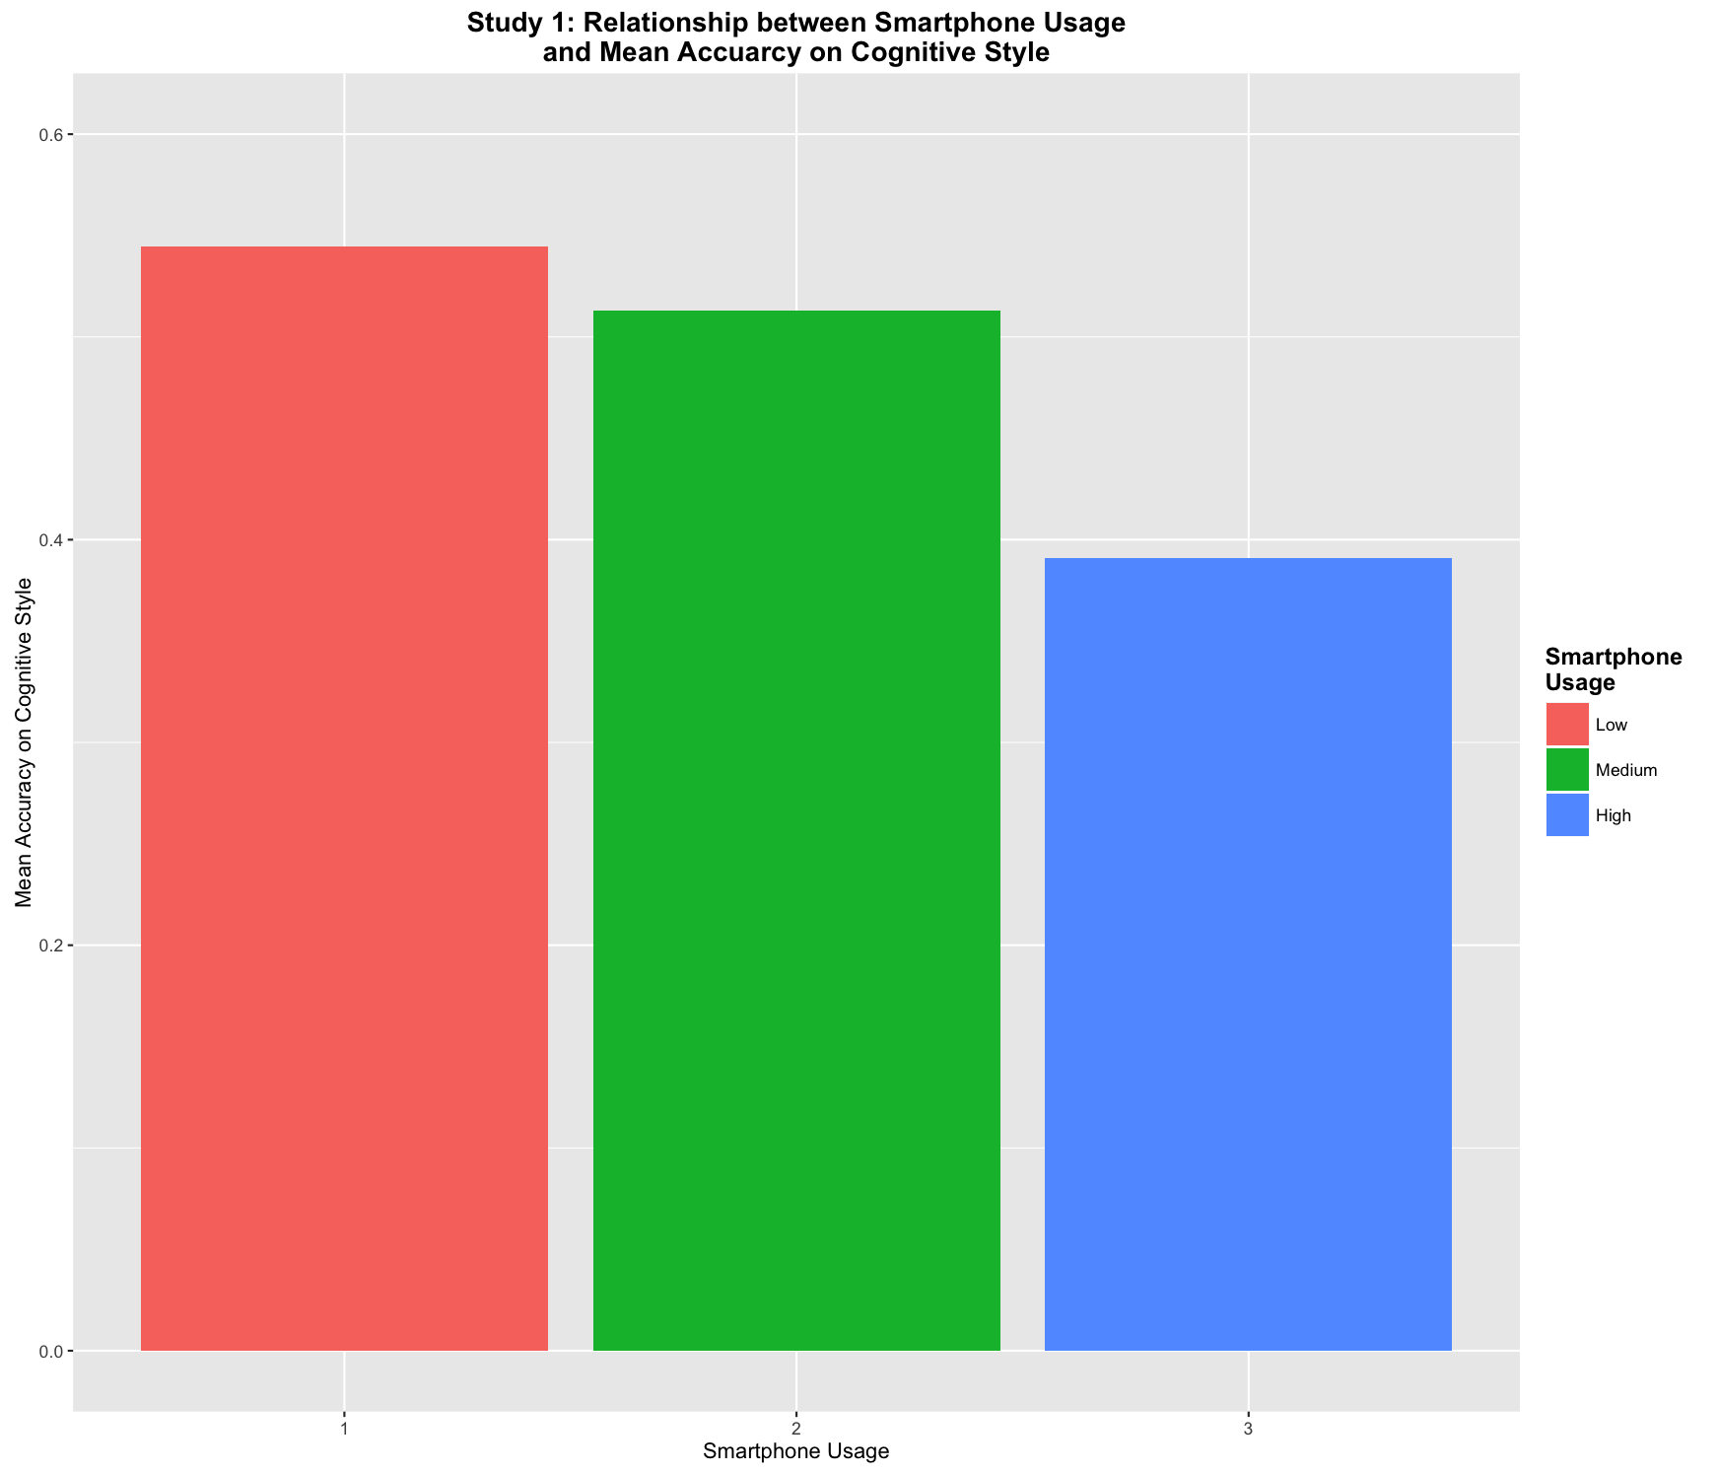
`

Slide 17
BAR GRAPH (THREE BARS)
library(ggplot2)
x<-ggplot(data = meanACS, aes(x=Study1SPoverall, y=Study1ACS, fill=Study1SPoverall))
x+geom_bar(stat = 'identity')+ylim (0,0.6)+ggtitle('Study 1: Relationship between Smartphone Usage\nand Mean Accuarcy on Cognitive Style') +ylab('Mean Accuracy on Cognitive Style')+xlab('Smartphone Usage')+theme(plot.title=element_text(face='bold', size = 14))+scale_fill_discrete(name='Smartphone\nUsage', breaks=c('1','2','3'), labels=c('Low', 'Medium','High'))+theme(legend.title=element_text(face='bold', size = 12))
Add information to ‘x’
‘/n’ (breaks the title)
‘geom_bar’ (bars for each group)
‘breaks’ (each # associates with each usage group ex: 1 = Low)
Notes:
R Markdown Assignment 4 Study 1 & 3 (3 bars)
R Markdown Assignment 5 (2 bars)

Slide 18


Slide 19
BAR GRAPH (THREE BARS + SE)
library(ggplot2)
meanACSSE<- summarySE(Study1, measurevar = 'ACS', groupvars = 'SP_Online')
x<-ggplot(data= meanACSSE, aes(x= SP_Online, y=ACS, fill=SP_Online))+geom_bar(stat = 'identity')
x+ geom_errorbar(aes(ymin=ACS-se, ymax=ACS+se, width=.2)) + ylim (0,0.6)+ggtitle('Study 1: Relationship between Smartphone Usage\nand Mean Accuarcy on Cognitive Style') +ylab('Mean Accuracy on Cognitive Style')+xlab('Smartphone Usage')+theme(plot.title=element_text(face='bold', size = 14))+scale_fill_discrete(name='Smartphone\nUsage', breaks=c('1','2','3'), labels=c('Low', 'Medium','High'))+theme(legend.title=element_text(face='bold', size = 12))
‘ymin, ymax’ (-se, +se respectively)
Notes:
R Markdown Assignment 4 Study 1 & 3 (3 bars)
R Markdown Assignment 5 (2 bars)

Slide 20
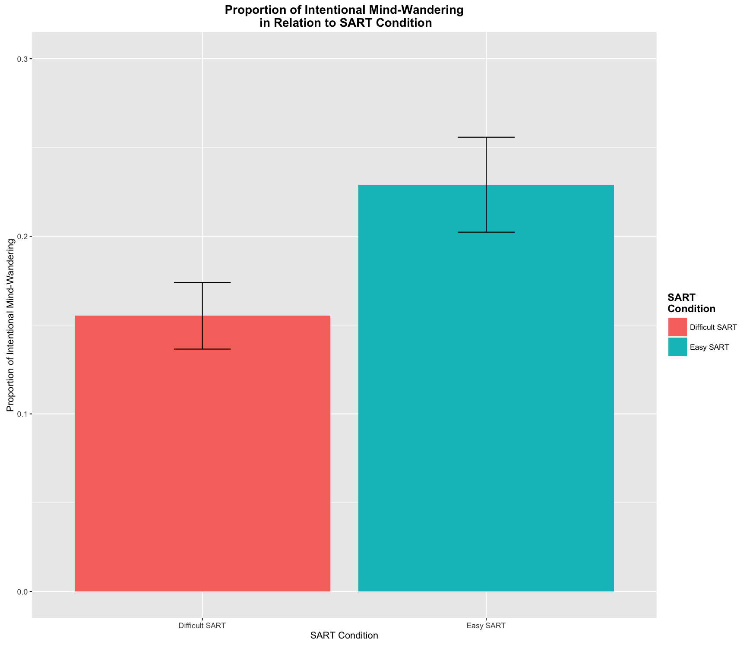

Slide 21
BAR GRAPH (TWO BARS + SE)
library(ggplot2)
meanIMWSART<-summarySE(Study1mean, measurevar = 'meanIMW', groupvars = 'Condition')
x<-ggplot(data= meanIMWSART, aes(x=Condition, y=meanIMW, fill=Condition))+geom_bar(stat='identity')
x+geom_errorbar(aes(ymin=meanIMW-se, ymax=meanIMW+se, width=.2))+ ylim (0,0.3)+ggtitle('Proportion of Intentional Mind-Wandering\n in Relation to SART Condition') +ylab('Proportion of Intentional Mind-Wandering')+xlab('SART Condition')+theme(plot.title=element_text(face='bold', size = 14))+scale_fill_discrete(name='SART\nCondition')+theme(legend.title=element_text(face='bold', size = 12))
Add information to ‘x’
‘/n’ (breaks the title)
‘ymin, ymax’ (-se, +se respectively)
No ‘breaks’ (data already had condition group labeled)

Slide 22
STANDARD ERROR
summarySE <- function(data=NULL, measurevar, groupvars=NULL, na.rm=FALSE,
conf.interval=.95, .drop=TRUE) {
library(plyr)
length2 <- function (x, na.rm=FALSE) {
if (na.rm) sum(!is.na(x))
else length(x)}
datac <- ddply(data, groupvars, .drop=.drop,
.fun = function(xx, col) {
c(N = length2(xx[[col]], na.rm=na.rm),
mean = mean (xx[[col]], na.rm=na.rm),
sd = sd (xx[[col]], na.rm=na.rm)
)}, measurevar)
datac <- rename(datac, c("mean" = measurevar))
datac$se <- datac$sd / sqrt(datac$N)
ciMult <- qt(conf.interval/2 + .5, datac$N-1)
datac$ci <- datac$se * ciMult
return(datac)}

Slide 23
HELPFUL LINKS
http://docs.ggplot2.org/0.9.3.1/geom_bar.html#
http://www.statmethods.net/
http://www.cookbook-r.com/
http://tutorials.iq.harvard.edu/R/Rgraphics/Rgraphics.html
https://www.r-bloggers.com/how-to-learn-r-2/

